Slide 1

Application of Unsupervised Learning in Detecting Behavioral Patterns in E-commerce Customers Paper ID: 429
ICDSMLA-23
Nagireddy Moneesh
Department of Computer Science and Engineering
Amrita School of Computing, Amrita Vishwa Vidyapeetham
5th International Conference on Data Science, Machine Learning & Applications

Slide 2
Objective Introduction Literature Review Dataset Methodology Results and Discussions Conclusion References
Presentation Contents

Slide 3
Uncover Customer Behavior Patterns: Utilize unsupervised machine learning with the Online Retail dataset, employing the Recency, Frequency, and Monetary (RFM) approach to identify distinct customer behavioral patterns. Optimize Clustering and Segmentation: Apply silhouette score analysis to determine the optimal number of clusters, followed by using the KMeans algorithm to accurately segment customers into clearly defined behavioral groups. Enhance Business Strategies: Leverage the insights gained from customer behavior clustering to refine marketing strategies, leading to improved service customization and increased sales effectiveness.
OBJECTIVE

Slide 4
Understanding E-Commerce and Customer Behavior E-Commerce Evolution: Highlight how e-commerce has progressed beyond mere online transactions to a sophisticated understanding of customer preferences and behavior prediction for personalized experiences. Data-Driven Insights: Emphasize the importance of analyzing online interactions, such as clicks, purchases, and cart abandonments, to gain valuable insights into customer behavior and preferences. Limitations of Traditional Methods: Discuss the limitations of conventional customer understanding methods like surveys and direct interactions, which may not always capture the full picture due to limited reach and potential biases.
INTRODUCTION

Slide 5
Leveraging Machine Learning for Enhanced Customer Insights Role of Clustering in E-Commerce: Introduce clustering, specifically KMeans, as a pivotal machine learning technique to categorize customer behaviors into distinct, manageable groups, improving the understanding of diverse shopping patterns. RFM Analysis for Customer Segmentation: Explain the Recency, Frequency, Monetary (RFM) method as a tool to analyze customer behavior, helping businesses segment their customers more effectively based on their purchase history and spending habits. Optimizing Clusters with Silhouette Score: Describe the use of the silhouette score in determining the optimal number of customer clusters, ensuring accurate segmentation and enabling businesses to tailor their strategies for enhanced customer satisfaction and experience.
INTRODUCTION(contd.)

Slide 6
K-means Clustering Algorithm Adaptability by Ching-Hsue Cheng, You-Shyang Chen: Explores K-means' flexibility for various datasets, optimizing for noisy data and generating clear clusters, ideal for customer segmentation. RFM Analysis in Customer Behavior by David L. Olson, Georg Lauhoff: In-depth examination of RFM model, advocating for integrating machine learning to enhance accuracy in predicting customer purchasing habits. Customer Segmentation Clustering Approaches by Shreya Tripathi, Aditya Bhardwaj, Poovammal Eswaran: Reviews various clustering methods for customer segmentation, suggesting alternatives to K-means for specific data types or business needs. K-Mode Clustering in E-Commerce by Deepali Kamthania, Ashish Pahwa, Srijit S. Madhavan: Introduces K-Mode clustering for categorical e-commerce data, focusing on its effectiveness in market segmentation and visualization strategies. RFM Analysis in China's Online Retail by Wiharto Wiharto, Esti Suryani: Highlights RFM model's role in understanding customer value in China's online retail, using clustering algorithms to tailor marketing strategies.
LITERATURE REVIEW

Slide 7
Source of Data: Dataset obtained from the UCI Machine Learning Repository, a notable source for machine learning datasets. Dataset Focus: "Online Retail" dataset, showcasing sales data from a primarily UK-based e-commerce business. Data Details: Each record includes product description, quantity ordered, invoice date, unit price, customer ID, and customer's country. Data Volume and Scope: Over 500,000 entries, offering a comprehensive overview of the company's sales and customer interactions. Insights Offered: Enables analysis of customer preferences, buying frequency, and spending patterns. Project Relevance: Ideal for understanding and segmenting customer behaviors in e-commerce, enhancing our research in customer pattern analysis.
DATASET

Slide 8
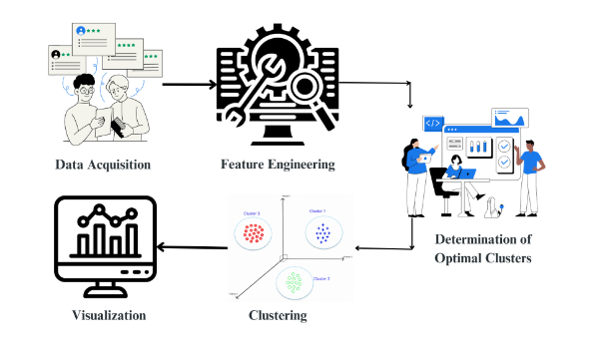
METHODOLOGY
Data Acquisition and Preparation
Data Source: Sourced the 'Online Retail' dataset from the UCI Machine Learning Repository, offering comprehensive customer purchase details.
Initial Data Exploration: Utilized Python and Pandas library for data loading and initial analysis. Employed describe() and isnull().sum() functions for understanding data distribution and identifying missing values.
Data Quality Assurance: Removed rows with missing customer IDs and filtered out transactions with negative quantities to maintain data integrity.
Feature Addition: Introduced a 'TotalPrice' column, calculating the total expenditure for each transaction (Quantity * UnitPrice).

Slide 9
METHODOLOGY(contd.)
Feature Engineering, Clustering, and Visualization
RFM Analysis Preparation: Computed Recency, Frequency, and Monetary values for each customer. Addressed skewness and standardized RFM data using logarithmic transformation and sklearn's StandardScaler.
Optimal Cluster Determination: Applied silhouette score method to identify the best number of clusters using KMeans algorithm from sklearn, analyzing scores for cluster counts ranging from 2 to 10.
Clustering Implementation: Segmented customers using KMeans clustering based on their RFM metrics, ensuring homogeneity within each cluster.
Visualization and Analysis: Utilized Seaborn's pairplot function for a multi-dimensional view of customer segments, aiding in understanding group dynamics and informing targeted business strategies.

Slide 10
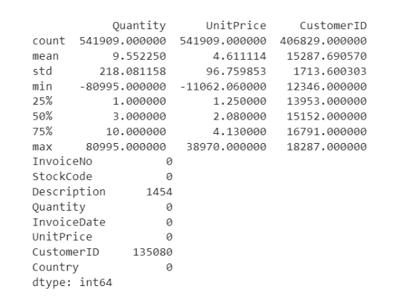
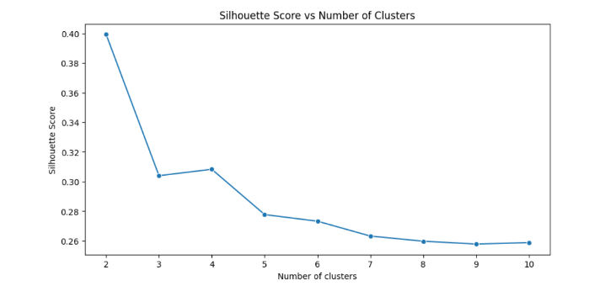
RESULTS AND DISCUSSIONS
Statistical summary and overview of the initial Online Retail dataset
Silhouette Score Plot illustrating optimal cluster number determination

Slide 11
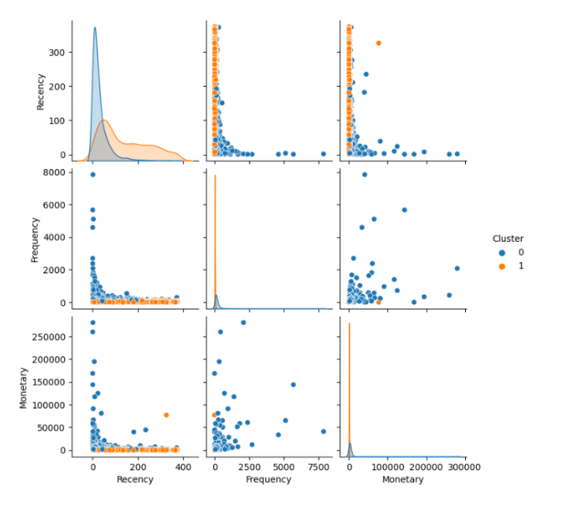
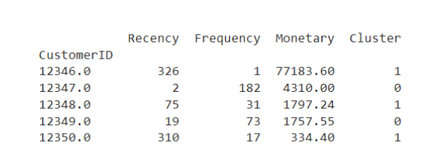
RESULTS AND DISCUSSIONS
Tabulated results showcasing RFM-based customer clustering
Pairplot visualization of RFM clusters, highlighting behavioral stratifications

Slide 12
RESULTS AND DISCUSSIONS
Initial Data Overview: Statistical summary of the dataset including count, mean, standard deviation, and percentiles. Analysis of missing values for robust data integrity.
Silhouette Score for Cluster Optimization: Graphical representation of silhouette scores vs. cluster numbers, identifying the optimal cluster count for distinct segmentation.
RFM Clustering Result: Implementation of KMeans clustering algorithm, with a snapshot of the RFM table showing customer segmentation into clusters based on purchasing behaviour.
RFM Visualization with Pairplot: Utilization of Seaborn’s pairplot for multi-dimensional visualization, illustrating pairwise relationships of RFM values across clusters, highlighting unique patterns and behaviours.

Slide 13
Successfully segmented customers in the "Online Retail" dataset using Recency, Frequency, and Monetary metrics coupled with KMeans clustering, unveiling distinct buying behaviors. Utilized the silhouette score method for determining the ideal number of clusters, achieving a balanced grouping of customer segments. Enhanced understanding of customer segments through detailed visualizations, including pairplots, highlighting the clear boundaries among different RFM clusters. The study's methodology offers replicable potential for diverse retail contexts, underscoring the significance of data-driven strategies in enhancing customer experience and business profitability.
CONCLUSION

Slide 14
REFERENCES
C.-H. Cheng and Y.-S. Chen, “Classifying the segmentation of customer value via RFM model and RS theory,” Expert Systems with Applications, vol. 36, no. 3, pp. 4176–4184, Apr. 2009, doi: https://doi.org/10.1016/j.eswa.2008.04.003.
M. Saravanan, Prasad, G., Jagadeesan, M., Raghu Raman, and V Smrithi Rekha, “Group Recommender Model for Boosting and Optimizing Customer Purchases”, in Advances in Social Networks Analysis and Mining (ASONAM), 2012 IEEE/ACM International Conference on, 2012.
Tripathi, Shreya \& Bhardwaj, Aditya \& Eswaran, Poovammal. (2018). Approaches to Clustering in Customer Segmentation. International Journal of Engineering \& Technology. 7. 802. 10.14419/ijet.v7i3.12.16505.
Kamthania, Deepali \& Pahwa, Ashish \& Madhavan, Srijit. (2018). Market Segmentation Analysis and Visualization Using K-Mode Clustering Algorithm for E-Commerce Business. Journal of Computing and Information Technology. 26. 57-68. 10.20532/cit.2018.1003863.
Ashwin, V., Menon, V., Devagopal, A.M., Nived, P.A., Udayan Divya, J. (2023). Detection of Fraudulent Credit Card Transactions in Real Time Using SparkML and Kafka. In Proceedings of 3rd International Conference on Recent Trends in Machine Learning, IoT, Smart Cities and Applications. Lecture Notes in Networks and Systems, vol 540. Springer.

Slide 15
Thank you Questions & Discussion

